Slide 1

Cinema Rating Logistic Regression Model
“Siskel and Ebert” style, machine learning model that predicts popular movie ratings as ‘high’ or ‘low.’

Slide 2
Data Analyst
Mindy B.
Data Analyst
Masters in Data Analytics at WGU

Slide 3
Project Subject Context
Siskel and Ebert were film critics from Chicago
Years active: 1975 – 1999
Known for their binary "Thumbs Up or Thumbs Down" summations of movies
Set standard of movie ratings in American culture
Together they are credited with forming modern day film criticism

Slide 4
Project Subject Context
IMDb.com is the largest internet movie database
Ranked as the 52nd most visited website in 2019
Features popular user ratings, reviews for movies
Began as a fan-operated movie database
Has been owned and operated by Amazon since 1998.

Slide 5
Capstone Topic
This capstone project utilizes two popular cinema movie datasets sourced from Kaggle.com. These datasets encompass a wide range of information from 10,000 movies, including IMDb ratings, vote counts, and box office earnings. Through this dataset, we gained valuable insights into the key metrics contributing to a movie's success and its performance relative to other films in the cinema industry.

Slide 6
Research Question
What is the anticipated rating a movie can achieve by leveraging a set of featured variables extracted from popular movie datasets?

Slide 7
IMDb ‘rating’
The ‘rating’ variable in this dataset serves as an indicator of a movie's popularity among both fans and critics. This rating is composed of the average IMDB votes of the movie out of 10. For the purposes of this project this target variable needed to be encoded to a binary variable of ‘0’ or ‘1.’ The two choices were:
‘Low,’ or ’0,’ which included ratings from 7 and below
‘High,’ or ‘1,’ which included ratings 7 and above

Slide 8
Hypothesis
The established null and alternative hypotheses for this analysis project:
Null hypothesis: The independent variables have no statistically significant effect on the dependent variable, average IMDb movie rating of high or low from the Internet Movie Database. Alternate Hypothesis: The independent variables have a statistically significant effect on the dependent variable, average IMDb movie rating of high or low from the Internet Movie Database.

Slide 9
Project Goal
To successfully build a logistic regression model to predict a movie's rating based on independent variables, the null hypothesis must be rejected, and the alternate hypothesis must be validated as accurate. If an effective model is generated, it can then be used to predict the rating of a new movie.

Slide 10
Approach
Exploratory Data Analysis
Feature Selection
Evaluation/ Conclusion
Performance
Model Selection

Slide 11
Data Analysis Process
The steps involved in this analysis and building the model process include:
Data collection
Data wrangling
Data cleaning
duplicates
missing or null values
outliers
Encoding categorical variables
Data exploration analysis
Feature selection
Splitting data (Test/Train)

Slide 12
Data Collection
“IMDB Top 10,000” movie dataset
title: The name/title of the movie
year: The release year of the movie
runtime: The total duration/length of the movie in minutes
certificate: The age certification or rating of the movie (e.g., PG, R, U/A)
genre: The category or type of movie (e.g., Drama, Action, Romance)
director: The director of the movie
stars: Leading actors and actresses featured in the movie
rating: The average IMDB rating of the movie out of 10
metascore: The metascore rating based on critical reviews
votes: The total number of user votes/ratings the movie received on IMDB
gross: The total box office collection/gross earnings of the movie in millions

Slide 13
Data Collection
“Movies Metadata” dataset
The Movies Metadata file contains information on 45,000 movies featured in the Full MovieLens dataset. With several metadata points, for purposes of this project only the following variables were kept.
budget: cinema budget for the movie
popularity: how popular the movie
revenue: how much money the movie brought in
runtime: how long the movie was in minuets
title: title of the movie
vote_average: average of votes
vote_count: how many people voted.

Slide 14
Data Wrangling
Joining two datasets together in SQL (Structured query language)
Convert ratings variable (1-10) to Low and High
Convert string of actors, to first two actors
Convert string of genres, to first listed genre
Data file consisting of 16 columns and 9,720 rows of movies
Title, Runtime, Rating, Metascore, Votes, Gross, Popularity, Revenue, Vote Average, Vote Count, Stars, Rating-2, First Genre, Star 1, Star 2

Slide 15
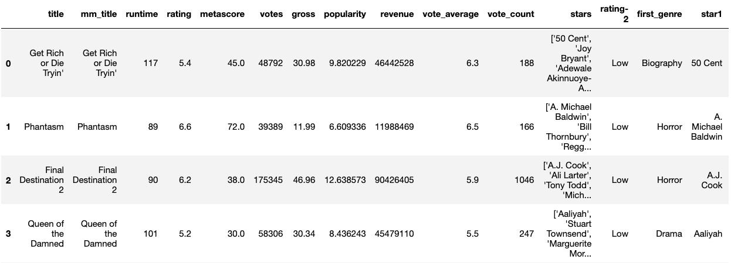
Dataframe

Slide 16
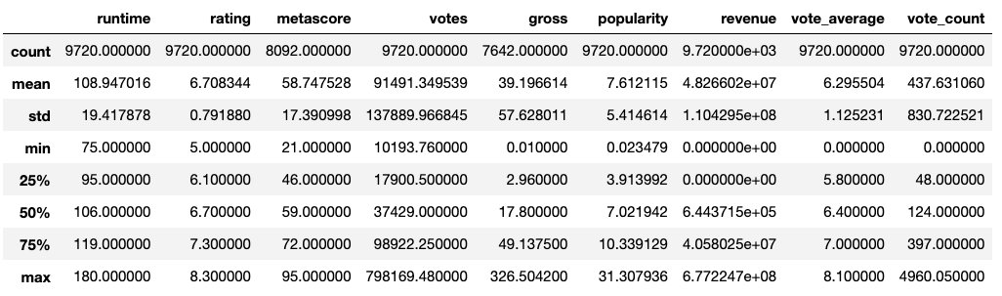
Dataframe

Slide 17
Data Cleaning
Removing duplicates
Identifying and treating missing data
Identifying and treating outliers through exploratory data analysis (EDA)

Slide 18
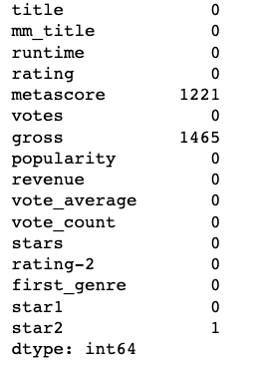
Data Cleaning
Treating Missing data

Slide 19
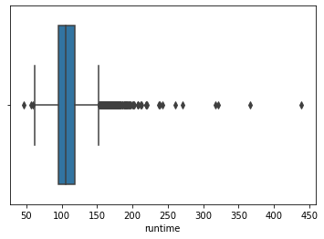
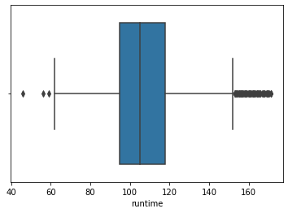
Data Cleaning
EDA (exploratory data analysis) - treating outliers; ‘runtime’ variable

Slide 20
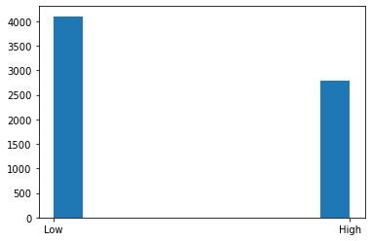
Exploratory Data Analysis
Counts of how many movies are in ‘rating-2’ variable

Slide 21
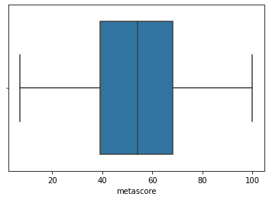
Exploratory Data Analysis
Boxplot of ‘metascore’ variable

Slide 22
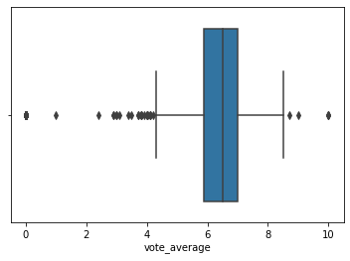
Exploratory Data Analysis
Boxplot of ‘vote_average’ variable

Slide 23
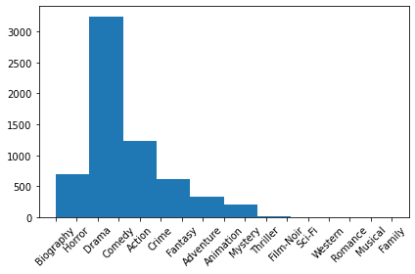
Exploratory Data Analysis
Histogram of ‘genre’ variable

Slide 24
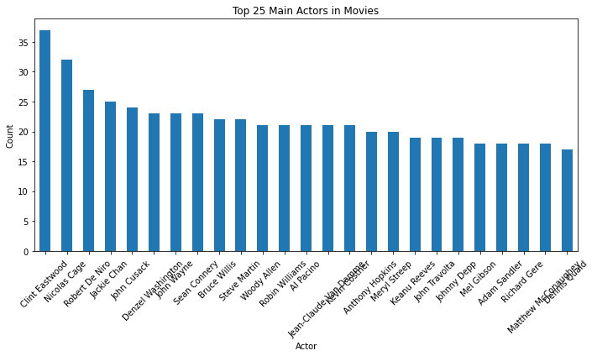
Exploratory Data Analysis
Histogram of ‘star #1’ variable

Slide 25
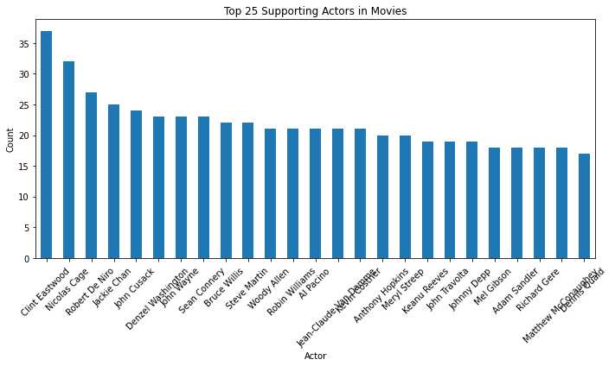
Exploratory Data Analysis
Histogram of ‘star #2’ variable

Slide 26
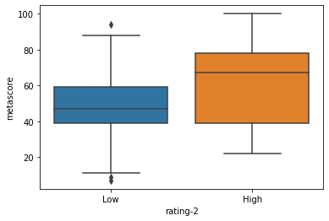
Exploratory Data Analysis
Bivariate statistics of ‘rating-2’ and ‘metascore’ variables

Slide 27
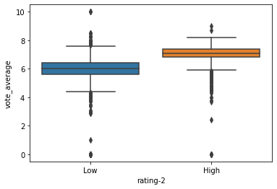
Exploratory Data Analysis
Bivariate statistics of ‘rating-2’ and ‘vote_average’ variables

Slide 28
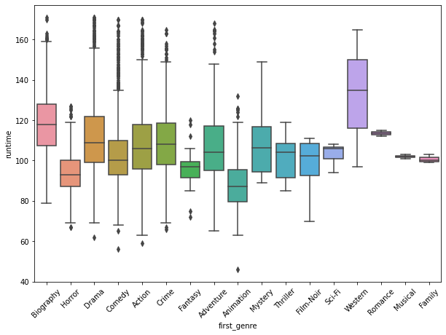
Exploratory Data Analysis
Bivariate statistics of ‘first_genre’ and ‘runtime’ variables

Slide 29
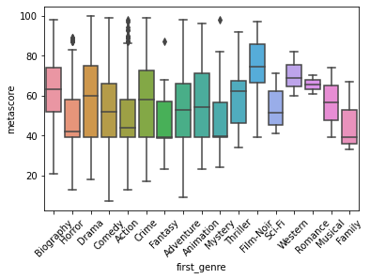
Exploratory Data Analysis
Bivariate statistics of ‘first_genre’ and ‘metascore’ variables

Slide 30
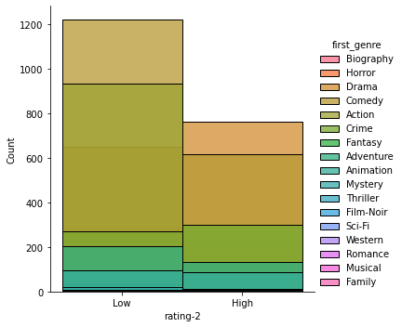
Exploratory Data Analysis
Bivariate statistics of ‘first_genre’ and ‘rating-2’ variables

Slide 31
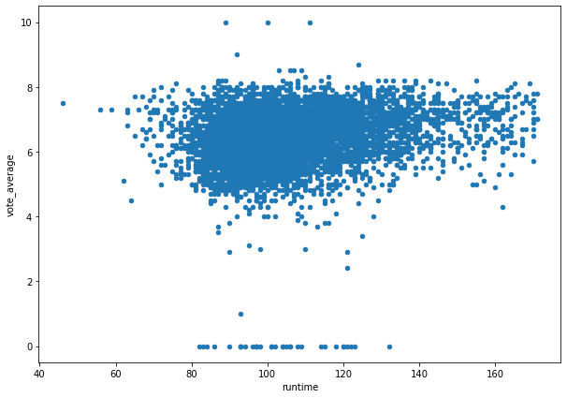
Exploratory Data Analysis
Bivariate statistics scatterplot of ‘vote_average’ and ‘runtime’ variables

Slide 32
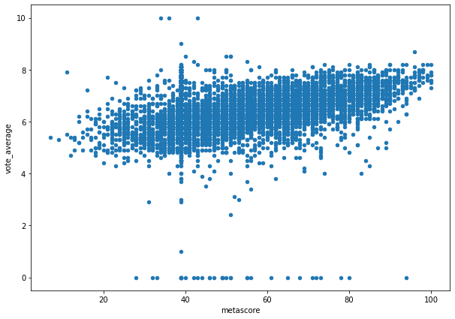
Exploratory Data Analysis
Bivariate statistics scatterplot of ‘vote_average’ and ‘metascore’ variables

Slide 33
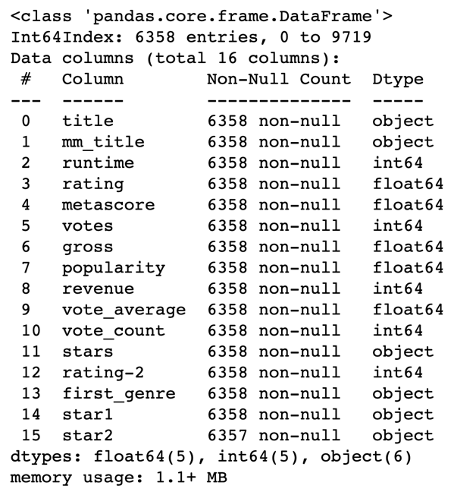
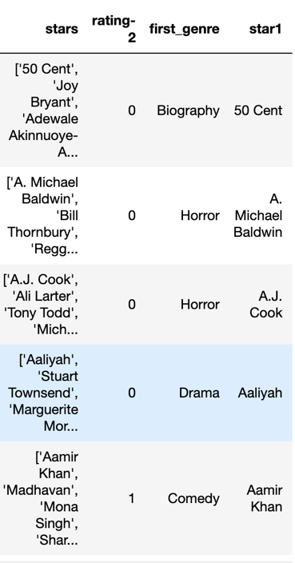
Encoding Categorical Variables
Encoding ‘rating’ variable from text to numeric; ‘low’ - ‘0’ or ‘high’ – ‘1’

Slide 34
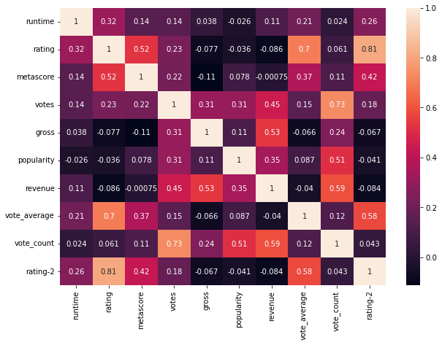
Feature Selection
Correlation heat map to show variables that have the highest correlations with the ’rating-2’ target variable;
‘vote_average’
‘metascore’
‘runtime’

Slide 35
Splitting Data
A training dataset is used to train the ML model, running congruously is a testing dataset to measure how accurate the ML model is performing.
Data splitting makes this possible in Python.
This technique divides the dataframe into two parts: training and testing.
Common practice is 80/20 split – 80% for training; 20% for testing.

Slide 36
If a cinema production company could accurately forecast a movie's rating based on factors like actors, budget, genre, rating, revenue, runtime, language, and more, it could provide significant advantages for everyone involved. Ultimately, the rating serves as an indicator of a movie's popularity among fans and critiques alike. Identifying the variables that exhibit strong correlations with higher ratings can enhance predictive modeling for the cinema industry.
Why Data Science AND MACHINE LEARNING

Slide 37
How would having a “Siskel and Ebert” style movie critic machine learning model affect the movie industry?

Slide 38
Summary
What the data showed:
Drama films are more popular in “high” ratings
Action films are more popular in “low” ratings
Clint Eastwood, Nicolas Cage, Robert DeNiro, Jackie Chan were the top actors, staring in several movies
Vote averages are higher in these genres
Metascore means are higher in biography and film-noir genres

Slide 39
Summary
What the ML Model showed:
Logistic regression prediction model, created in Python, had an accuracy of 86%
Number of observations of this model was 6,358
The pseudo r-squared score indicates a good fit model at 0.4493.
P-value for the dependent variables is less than 0.05, indicating there is strong evidence to reject the null hypothesis, indicating the dependent variables do have an impact on the prediction ranking outcome.

Slide 40
Limitations
The availability of an adequate number of data points required to construct a statistically robust machine learning model.
The pandemic undeniably altered how fan’s view, rate, and watch movies.
The larger movie dataset contained data that hadn't been updated beyond 2017. If this data were updated to 2023, it's possible that the model would have incorporated different variables or outcomes.
Possible bias in target variable of ratings

Slide 41
Expected Benefits
In terms of implementing this rating model system for predicting ratings in the cinema industry, it's important to consider the historical context. The cinema rating duo, Siskel and Ebert, set the standard until 1999. Their ratings and opinions were grounded in their personal experiences with the movies they reviewed. Their success stemmed from their ability to provide contrasting perspectives and critiques based on their individual life experiences and opinions. This machine learning prediction model is designed to replicate the tasks performed by human critics. It aims to demonstrate to the cinema industry which insights and indicators have the most significant impact on ratings.

Slide 42
Expected Benefits
There are several ways to advance this research project. A data analyst could construct a comparative linear regression model to predict a movie's precise numeric rating, using this model as a base. Additionally, an adding a web scraping project to acquire additional movie data, such as budgets of films, to gain deeper insights into the factors influencing a movie's ratings. Further analysis could be performed to formulate a composite target variable, encompassing factors like votes cast, gross profit, budget, etc., instead of relying solely on an already established rating.

Slide 43
Sources
Banik, Rounak. (2017). The Movies Dataset. Retrieved September 15, 2023 from https://www.kaggle.com/datasets/rounakbanik/the-movies-dataset
Devpura, Ashutosh. (August 2023). IMDb Top 10,000 Movies. Retrieved September 15, 2023 from https://www.kaggle.com/datasets/ashutoshdevpura/imdb-top-10000-movies-updated-august-2023

Slide 44
Sources
Sree. (2020, October 26). Predict Customer Churn in Python. Towards Data Science. https://towardsdatascience.com/predict-customer-churn-in-python-e8cd6d3aaa7
Li, Susan. (2017, September 28). Building A Logistic Regression in Python, Step by Step. Towards Data Science. https://towardsdatascience.com/building-a-logistic-regression-in-python-step-by-step-becd4d56c9c8
Datarmat. (2022, July 28). How to Perform Logistic Regression in Python(Step by Step). Data Science. https://www.datarmatics.com/data-science/how-to-perform-logistic-regression-in-pythonstep-by-step/
Stojiljkovic, Mirko. Logistic Regression in Python. Real Python. https://realpython.com/logistic-regression-python/
SalRite. (2018, December 15). Demystifying ‘Confusion Matrix’ Confusion. Towards Data Science. https://towardsdatascience.com/demystifying-confusion-matrix-confusion-9e82201592fd
Bock, Tim. (2022) How to Interpret Logistic Regression Coefficients. DISPLAYR. https://www.displayr.com/how-to-interpret-logistic-regression-coefficients/

